Slide 1
DEtection of spoiled food AND it’s TYPES in Agricultural
Muhammad hassan fa21-bce-051
Syed muhammad hashir fa21-bce-032

Slide 2
Outline
Introduction
Literature Review
Methodology
Flow chart
Results
Impacts
Conclusion

Slide 3
Introduction:
Ensuring the quality of fruits is essential for reducing food waste, maintaining consumer satisfaction, and adhering to safety standards.
In this project, we developed a Convolutional Neural Network (CNN) model to create an automated model to identify both fruit types and their quality, potentially reducing food waste and improving quality control in the food industry. We began by searching for a dataset of images showing different fruits in both fresh and rotten states.

Slide 4
Literature Review
The primary source of datasets was Kaggle, where we explored various datasets related to fruit classification. Kaggle also provided a wealth of codes and implementations by other people, which offered valuable understandings into different modeling techniques and preprocessing methods.
Beyond Kaggle, we conducted thorough online research using Google to find scholarly articles and open-source projects related to fruit classification using machine learning and computer vision. This research helped identify the best practices in data preprocessing, model architecture, and evaluation metrics.
we utilized YouTube as a resource to watch tutorials and project walkthroughs.

Slide 5
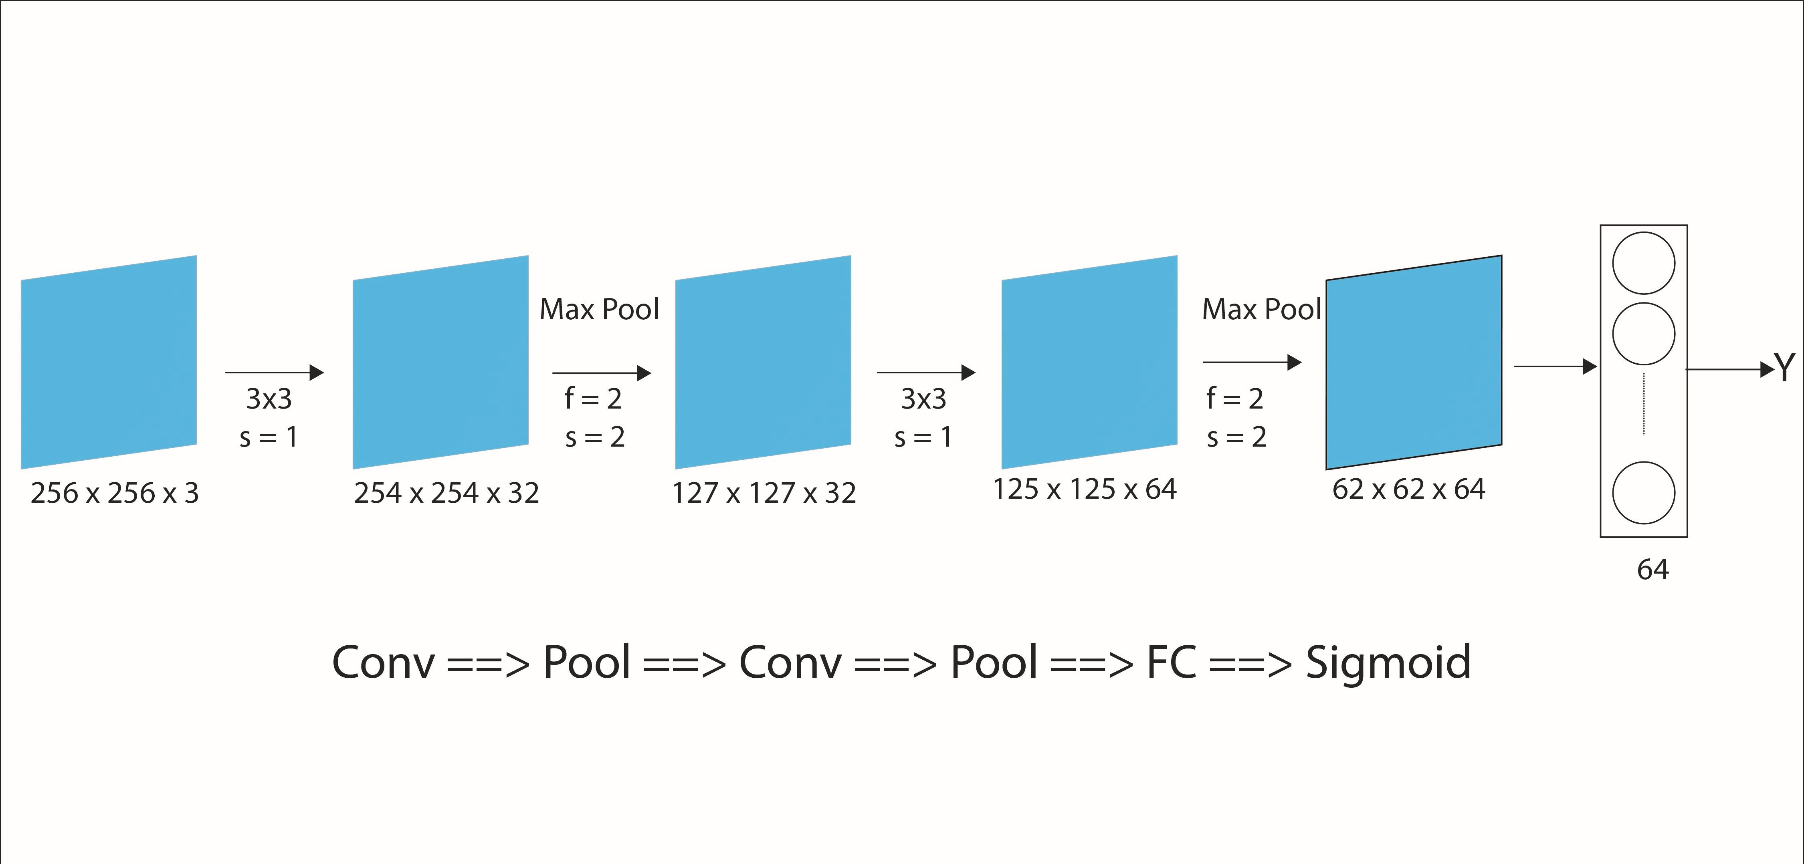
Methododlgy
Model Architecture BINARY CLASSFICATION

Slide 6
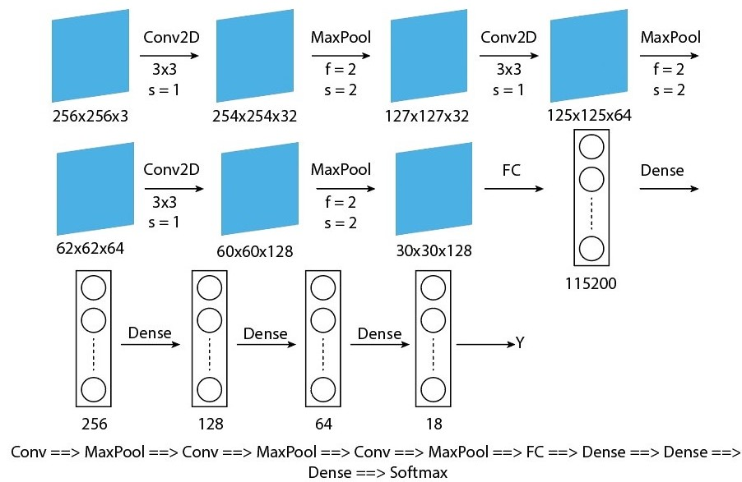
Methododlgy
Model Architecture MULTI_ CLASSFICATION

Slide 7
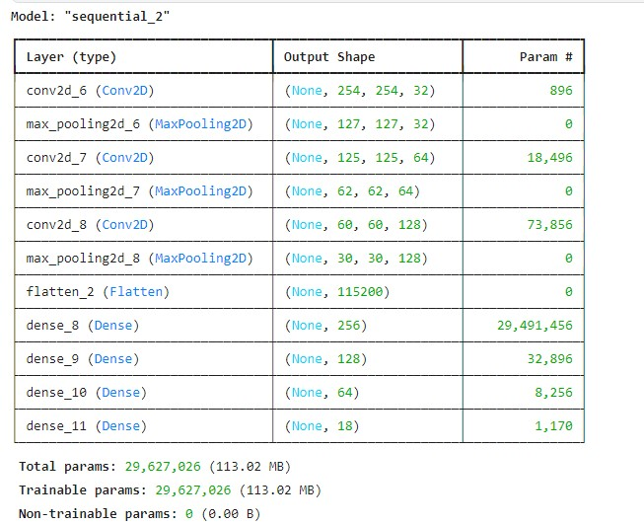
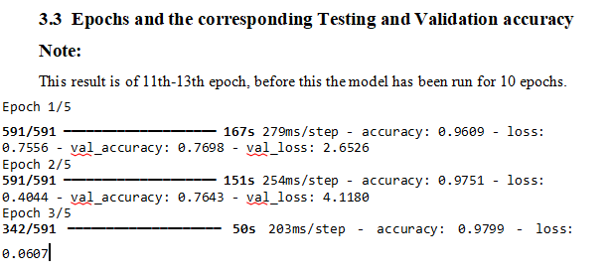
MODEL SUMMARY:

Slide 8
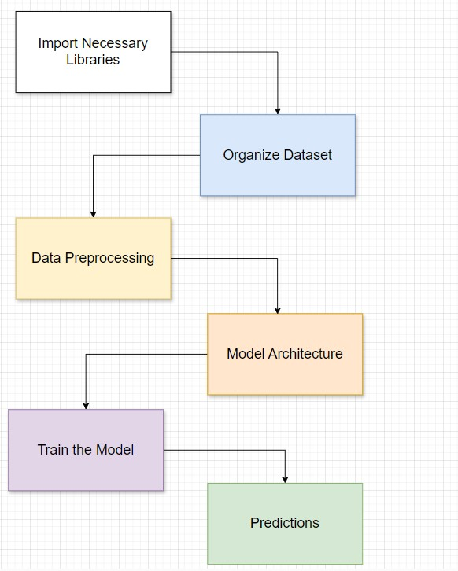
Flowchart

Slide 9
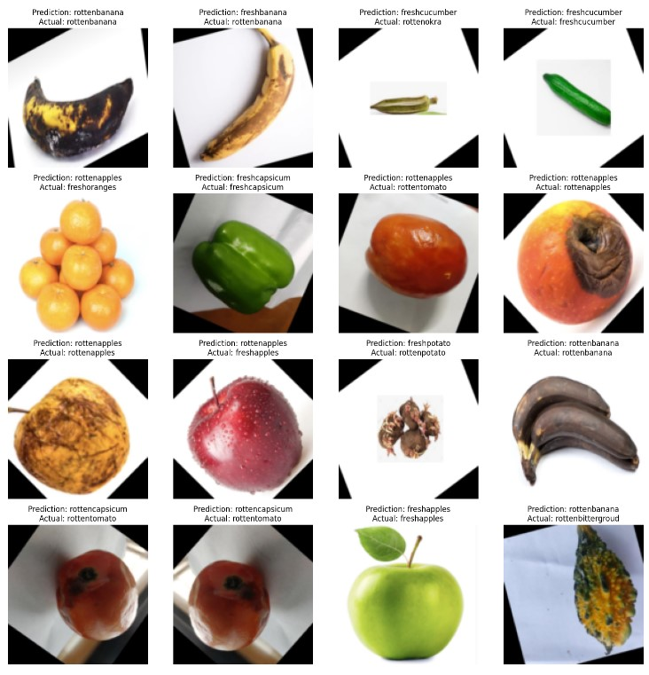
Results:
TEST 01 Multi Classfication:

Slide 10
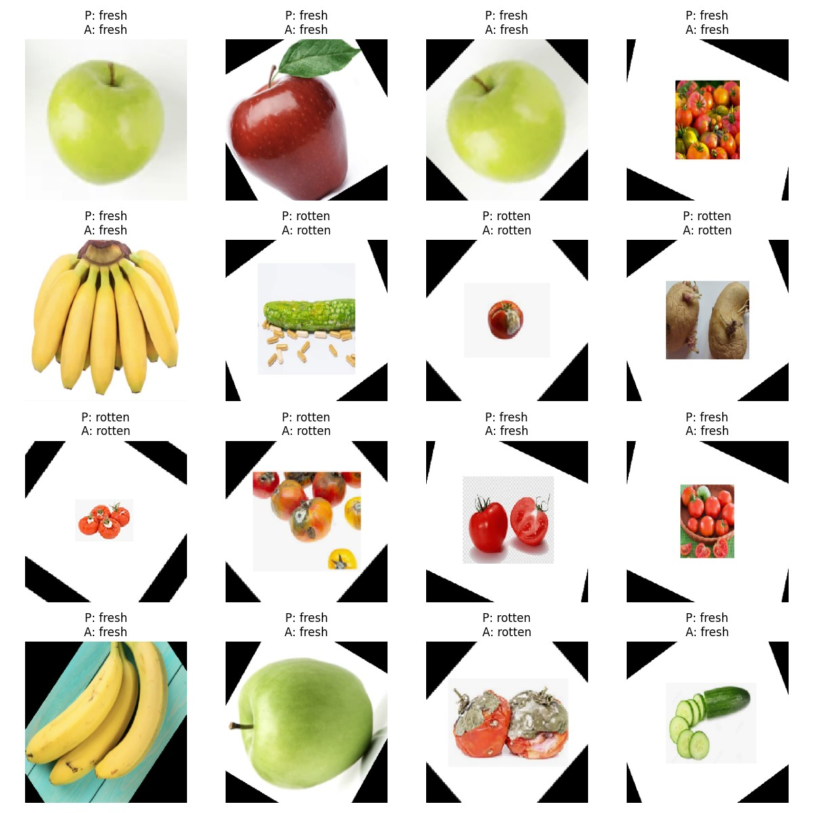
Results:
TEST 02 Binary Classfication:

Slide 11
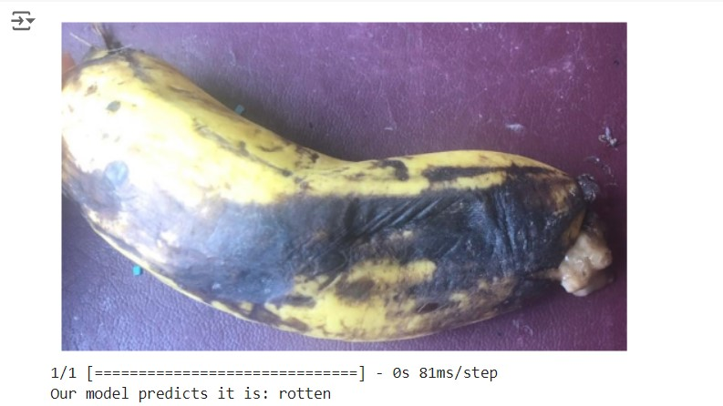
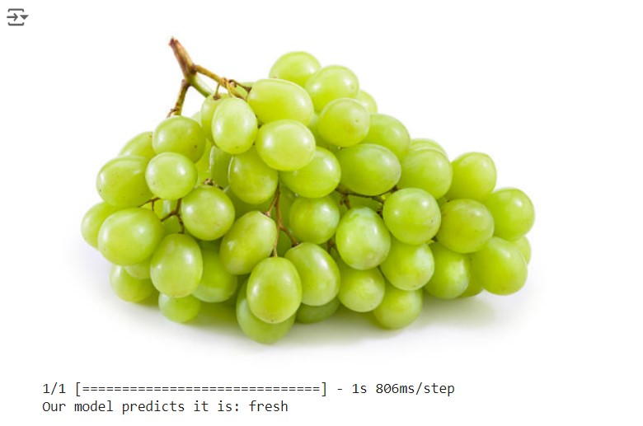
Results: TEST 03: we have predicted our own collected images and tested it on the mode grapes not include in our dataset ,we take it from ouside of dataset

Slide 12
Environmental and econimical impact
In agriculture, various technologies and practices have a significant impact on the environment, with both positive and negative effects. On the positive side, modern agricultural practices and technologies can enhance productivity, optimize resource use, and reduce environmental impact. On the negative side, some practices can lead to soil degradation, water pollution, and biodiversity loss.
In food industory it is used as a best detection device and their or lot of benefits

Slide 13
Conclusion
In this project, we developed a CNN model for binary classify fresh and rotten fruits, achieving a high accuracy of 98%. The model's ability to accurately predict fruit quality, even with images outside its training dataset, demonstrates its robustness and practicality.
As Well ,we also developed a CNN model to classify fresh and rotten fruits along with the fruit type, achieving a medium accuracy of 76%. The model's ability to predict fruit quality and fruit type, demonstrates its practicality
Automating fruit quality assessment can significantly reduce manual labor, minimize human error, and improve efficiency in the food supply chain. Our approach shows promise in contributing to food waste reduction and enhancing food safety.
This project underscores the potential of machine learning and computer vision technologies in revolutionizing agricultural practices and ensuring the delivery of high-quality produce to consumers.

Slide 14
Thank You!

